Slide 1
Randomized Algorithms CS648A
Lecture 4
Frievald’s algorithm – final analysis
Two problems from the last lecture
Random Variable and Expected value

Slide 2


Frievald’s Algorithm (Analyzing error probability)
$$ε$$
P( $D_{i1}^{}$ $∙x_{1}$ + … + $D_{in}^{}$ $∙x_{n}$ = 0 ) = ??
Question:
What can be the suitable partition of $Ω$?
➔ the partition defined by the values taken by all the r.v.’s excluding $x_{k}$.
…

Slide 3










Frievald’s Algorithm (Analyzing error probability)
$$ε$$
P( $D_{i1}^{}$ $∙x_{1}$ + … + $D_{in}^{}$ $∙x_{n}$ = 0 ) = ??
Question: What is the probability of $ε$conditioned on
any arbitrary but fixed values taken by all $x_{j}, j≠k$ ?
Answer: Consider any $n−1$ values $a_{1}, \text{…,} { a}_{k−1}, a_{k+1}, …,a_{n} ϵ \left\{0,1\right\}.$
$\text{P}\text{(}ℰ | x_{1}=a_{1}, \text{…}\text{,}x_{k−1}=a_{k−1},x_{k+1}=a_{k+1}, …,{x_{n}=a}_{n}$)
$=$ ?
$$=\text{P}\text{(}D_{i,k}^{}∙x_{k}=−(D_{i,1}^{} ∙a_{1}+\text{…}+D_{i,k−1}^{}∙a_{k−1}\text{+ }D_{i,k+1}^{}∙a_{k+1}{+ …D}_{in}^{}∙a_{n}\text{)}\text{)}$$
$=\text{P}\text{(}x_{k}=−(D_{i,1}^{} ∙a_{1}+\text{…}+D_{i,k−1}^{}∙a_{k−1}\text{+ }D_{i,k+1}^{}∙a_{k+1}{+ …D}_{in}^{} ∙a_{n}\text{)/}D_{i,k}^{}$)
$$≤½$$
$≤½$
$$= \text{P}\text{(}D_{i,1}^{} ∙ x_{1} +\text{…}+D_{i,k−1}^{}∙ x_{k−1} \text{+ }D_{i,k}^{}∙ x_{k} +D_{i,k+1}^{}∙{ x}_{k+1} {+ …D}_{in}^{}∙ x_{n} \text{ = 0}$$
$$\text{|}$$
$$x_{1}=a_{1}, \text{…} \text{,}x_{k−1}=a_{k−1},{ x}_{k+1}=a_{k+1}, …, {x_{n}=a}_{n} \text{)}$$
$$a_{1}$$
$$a_{k−1}$$
$$a_{k+1}$$
$$a_{n}$$
$$\text{)}$$
≠0
Since the value of all $x_{i},i≠k$have been determined due to conditioning, we can plug them in.
Since $x_{k}$ is independent of $x_{1},…x_{k−1},x_{k+1},…x_{n}$
Could be 0, 1 or some other number

Slide 4

Frievald’s Algorithm (Analyzing error probability)
Theorem:
Error probability of algorithm RandomProductVerify($A$,$B$,$C$) is at most $½$.
Question: How to increase the success probability ?

Slide 5
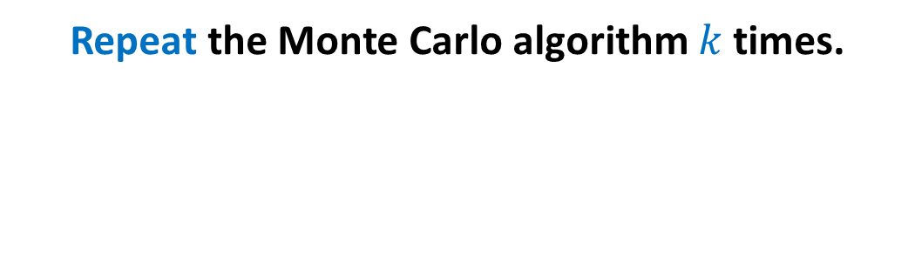
Probability Ampilification
Repeat the Monte Carlo algorithm $k$ times.

Slide 6
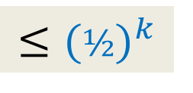
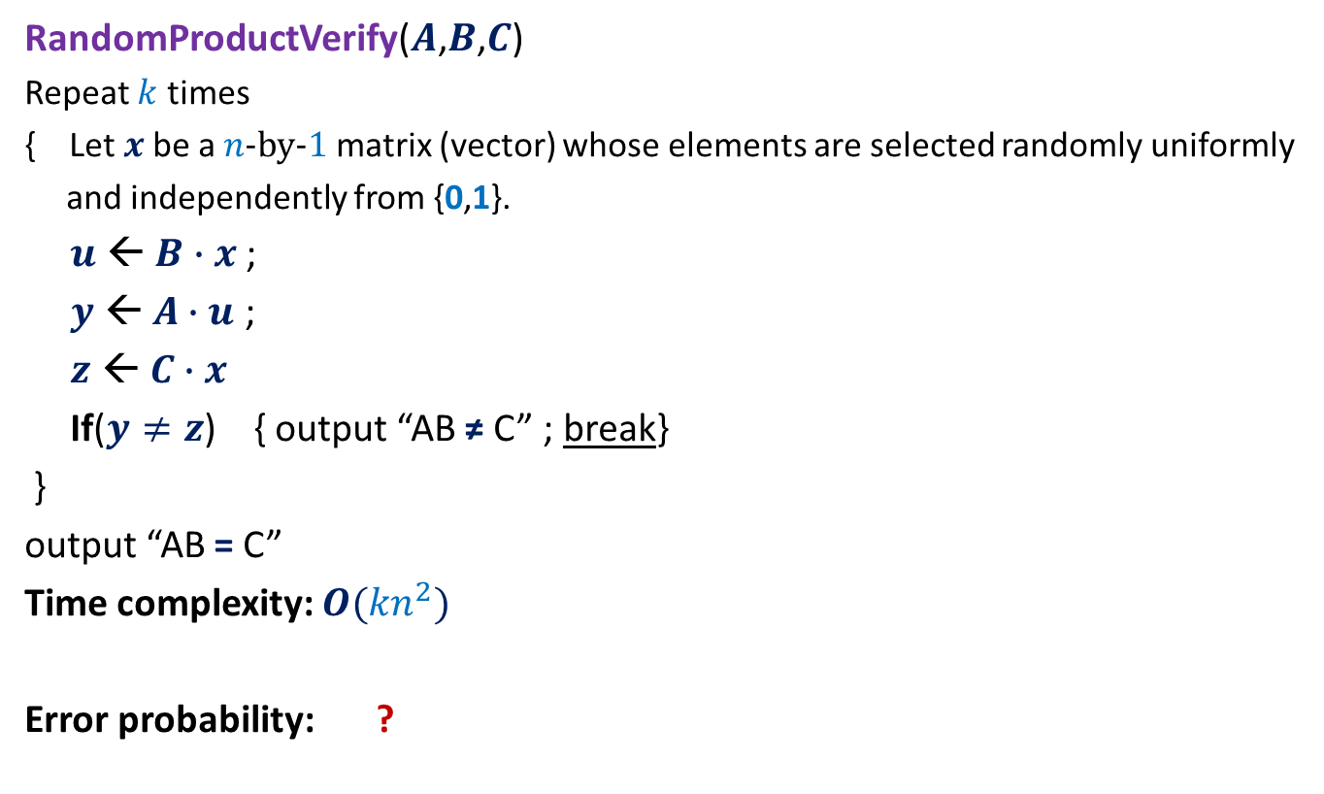
Frievald’s Algorithm (reducing the error probability)
AB ≠ C
RandomProductVerify($A$,$B$,$C$)
Repeat $k$ times
{ Let $x$be a $n$-by-$1$matrix (vector) whose elements are selected randomly uniformly
and independently from {0,1}.
$u$ ← $B∙x$ ;
$y$ ← $A∙u$ ;
$z$ ← $C∙x$
If($y≠z$) { output “AB ≠ C” ; break}
}
output “AB = C”
Time complexity: $O({kn}^{2})$
Error probability: ?
$$≤{(½)}^{k}$$

Slide 7

Frievald’s Algorithm (final result)
Theorem: Given three $n$-by-$n$matrices $A$, $B$, and $C$,
there is a Randomized Monte Carlo algorithm which determines $C≟A⨯B$.
The running time is $O(n^{2}log n)$, and the error probability is less than $n^{−2}$.

Slide 8
Balls into BINS
Problem 1

Slide 9



Balls into Bins
1 2 3 4 5 … $j$ … $m−1 m$
Pr[$i$th bin is empty] = ${(1−\frac{1}{n} )}^{m}$
Pr[$i$th and $k$th bin are empty] = ??
Pr[a specified set of $l$bins are empty] = ??
1 2 3 … $i$ … $n$
$${(1−\frac{2}{n} )}^{m}$$
$${(1−\frac{l}{n} )}^{m}$$

Slide 10
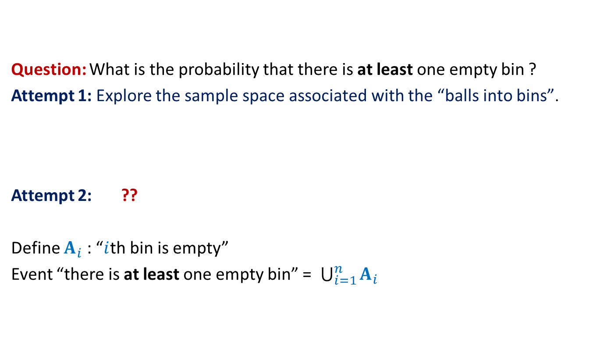
Balls into Bins
Question: What is the probability that there is at least one empty bin ?
Attempt 1: Explore the sample space associated with the “balls into bins”.
Attempt 2: ??
Define $A_{i}$ : “$i$th bin is empty”
Event “there is at least one empty bin” = $\bigcup_{i=1}^{n}{A_{i}}$
Express the event as union of some events …

Slide 11


Union of two Events
Given two events A and B defined over a probability space ($Ω$,P),
what is P(AUB) ?
A
B
Ω
P(AUB) = P(A) + P(B)
$−$ P(A∩B)

Slide 12
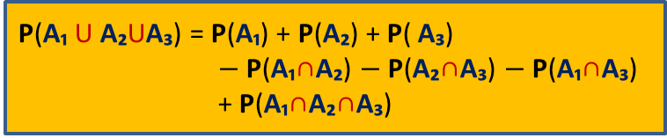

Union of three Events
Given three events A₁, A₂, A₃, defined over a probability space ($Ω$,P),
what is P(A₁ U A₂ U A₃) ?
A
B
C
Ω
P(A₁ U A₂UA₃) = P(A₁) + P(A₂) + P( A₃)
$−$ P(A₁∩A₂) $−$P(A₂∩A₃) $−$P(A₁∩A₃)
+ P(A₁∩A₂∩A₃)

Slide 13

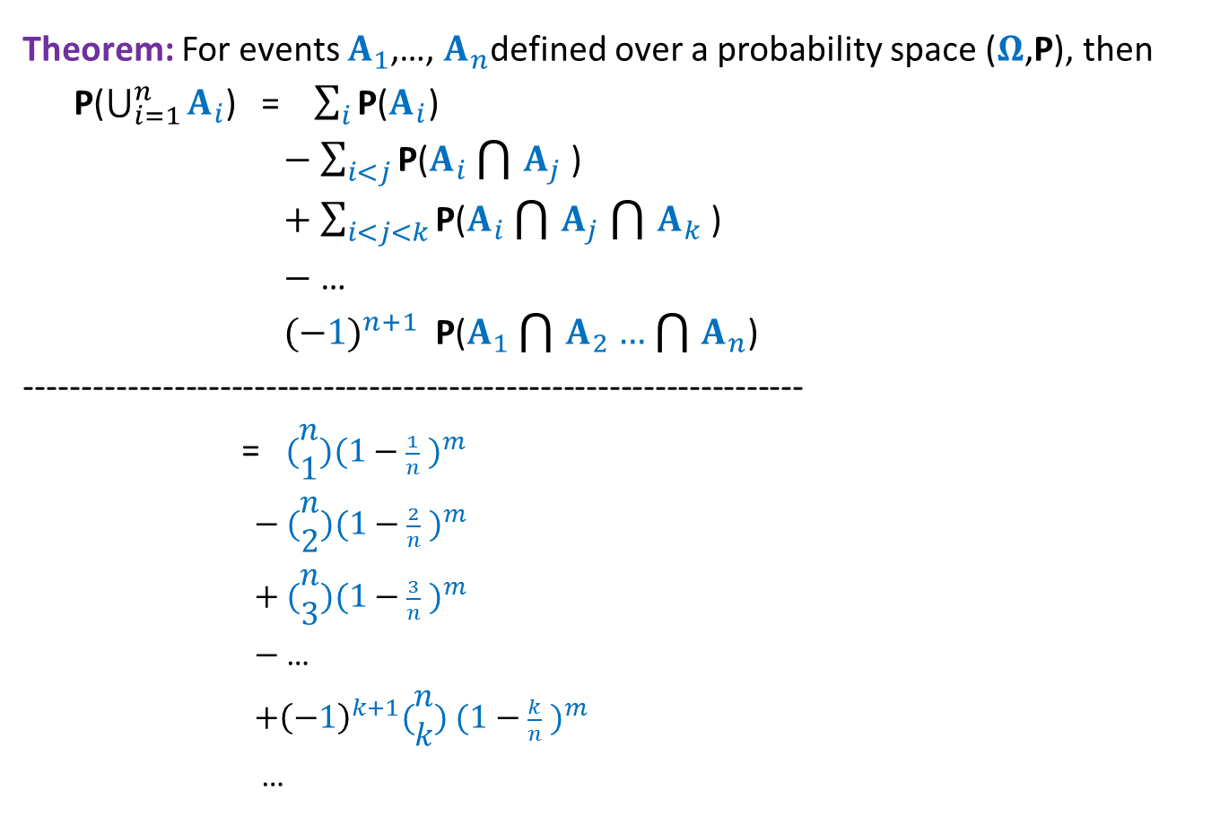
Balls into Bins
Theorem: For events $A_{1}$,…, $A_{n}$defined over a probability space ($Ω$,P), then
P($\bigcup_{i=1}^{n}{A_{i}}$) = $\sum_{i}{\text{P}\text{(}A_{i}\text{)}}$
$−$ $\sum_{i<j}{\text{P}\text{(}A_{i}\bigcap{A_{j}}\text{)}}$
$+$ $\sum_{i<j<k}{\text{P}\text{(}A_{i}\bigcap{A_{j}}\bigcap{A_{k}}\text{)}}$
$−$ …
${(−1)}^{n+1}$ $\text{P}\text{(}A_{1}\bigcap{A_{2}}…\bigcap{A_{n}}$)
--------------------------------------------------------------------
= $(\begin{matrix}n \\ 1\end{matrix}){(1−\frac{1}{n} )}^{m}$
$−$ $(\begin{matrix}n \\ 2\end{matrix}){(1−\frac{2}{n} )}^{m}$
$+$ $(\begin{matrix}n \\ 3\end{matrix}){(1−\frac{3}{n} )}^{m}$
$−$ …
${+\left(−1\right)}^{k+1}(\begin{matrix}n \\ k\end{matrix})$ ${(1−\frac{k}{n} )}^{m}$
…
$$p(n,m)$$

Slide 14
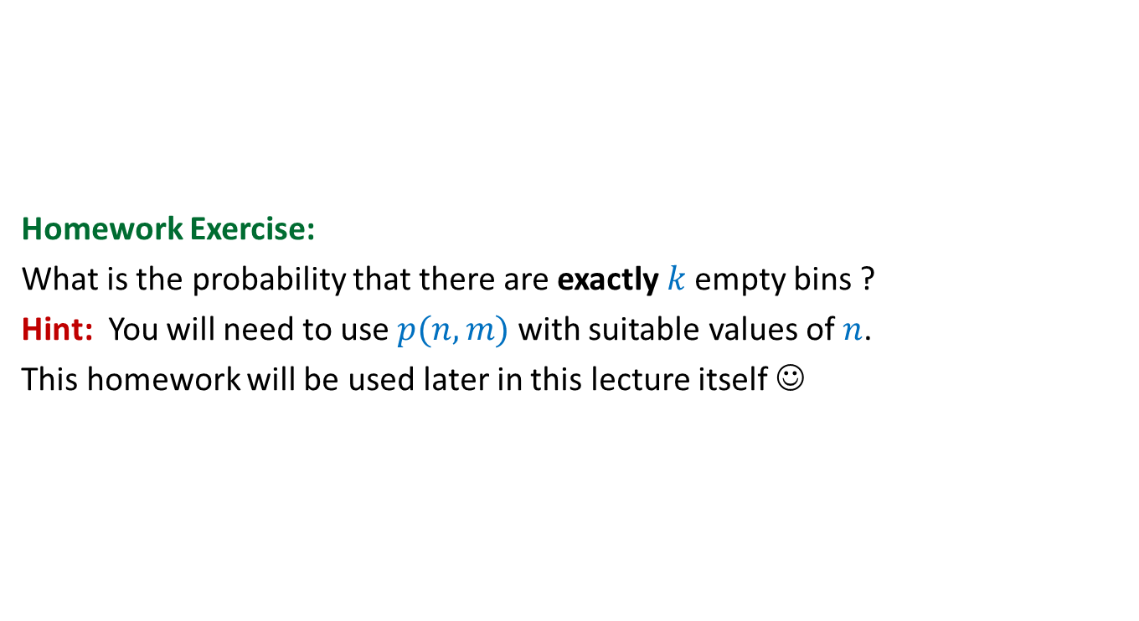
Balls into Bins
Homework Exercise:
What is the probability that there are exactly $k$empty bins ?
Hint: You will need to use $p(n,m)$ with suitable values of $n$.
This homework will be used later in this lecture itself ☺

Slide 15
Randomized Quick sort

Slide 16
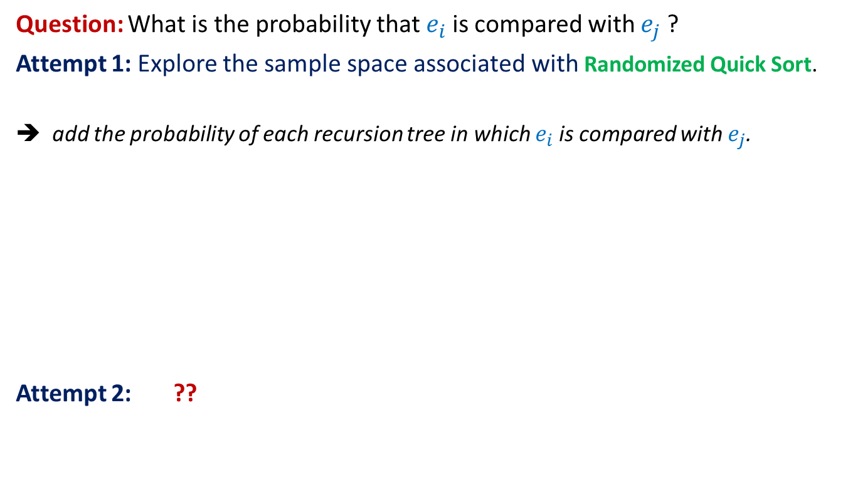
Randomized Quick Sort
Question: What is the probability that $e_{i}$is compared with $e_{j}$?
Attempt 1: Explore the sample space associated with Randomized Quick Sort.
➔ add the probability of each recursion tree in which $e_{i}$is compared with $e_{j}$.
Attempt 2: ??
Not a feasible way to calculate the probability
View the execution of RandomizedQuickSort from perspective of $e_{i}$ and $e_{j}$

Slide 17
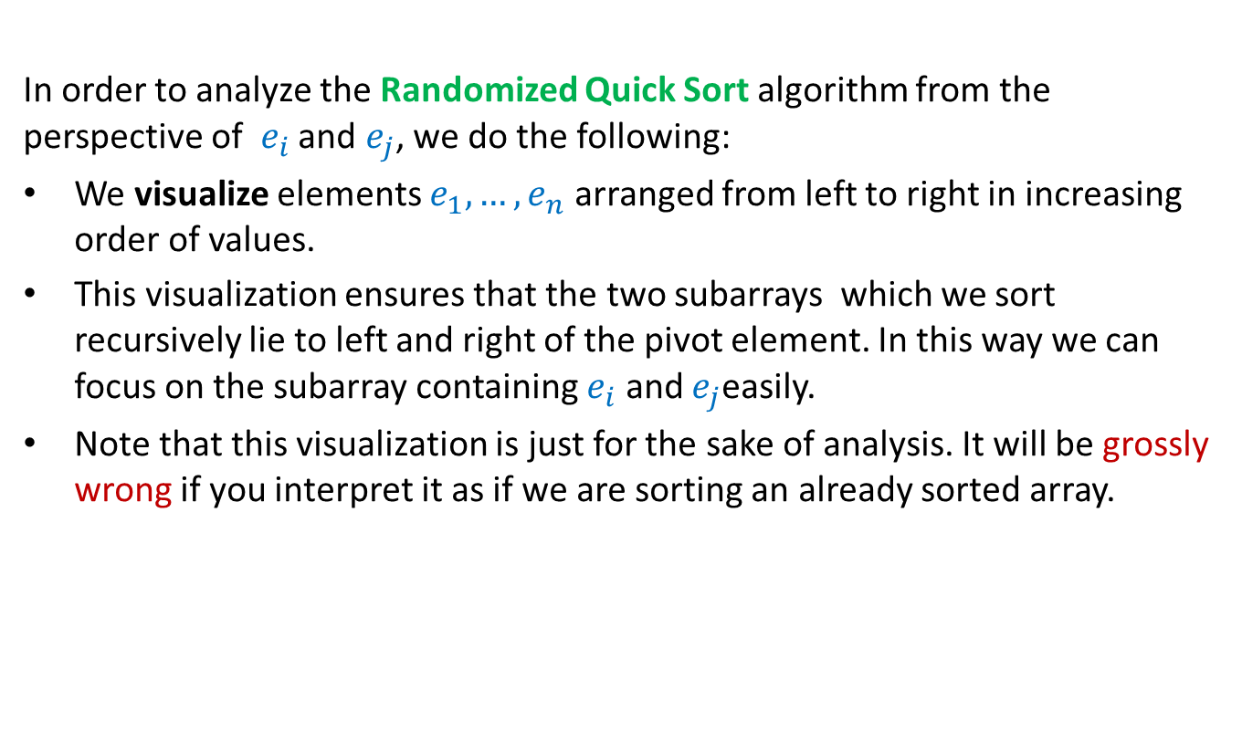

Randomized Quick Sort from perspective of $e_{i}$and $e_{j}$
In order to analyze the Randomized Quick Sort algorithm from the perspective of $e_{i}$ and $e_{j}$, we do the following:
We visualize elements $e_{1}, …, e_{n}$ arranged from left to right in increasing order of values.
This visualization ensures that the two subarrays which we sort recursively lie to left and right of the pivot element. In this way we can focus on the subarray containing $e_{i}$ and $e_{j}$easily.
Note that this visualization is just for the sake of analysis. It will be grossly wrong if you interpret it as if we are sorting an already sorted array.
Go through the next few slides slowly and patiently, pondering at each step. Never accept anything until and unless you can see the underlying truth yourself.

Slide 18



Randomized Quick Sort
from perspective of $e_{i}$and $e_{j}$
Recursion Tree
$$e_{i}$$
$$e_{j}$$
Elements of A arranged in Increasing order of values
Notes:
Let us look at the journey of ei and ej during an instance of randomized quick sort.
For this purpose, let us visualize all the elements of A arranged in the increasing order of values.
Let us see how the recursion tree unfolds itself.
In the first recursive call, obviously ei and ej are together.

Slide 19
Randomized Quick Sort
from perspective of $e_{i}$and $e_{j}$
Recursion Tree
$$e_{i}$$
$$e_{j}$$
pivot
. . .
. . .

Slide 20

Randomized Quick Sort
from perspective of $e_{i}$and $e_{j}$
Recursion Tree
$$e_{i}$$
$$e_{j}$$
pivot

Slide 21
Randomized Quick Sort
from perspective of $e_{i}$and $e_{j}$
Recursion Tree
$$e_{i}$$
$$e_{j}$$
pivot

Slide 22
Randomized Quick Sort
from perspective of $e_{i}$and $e_{j}$
Recursion Tree
$$e_{i}$$
$$e_{j}$$
pivot

Slide 23
Randomized Quick Sort
from perspective of $e_{i}$and $e_{j}$
Recursion Tree
$$e_{i}$$
$$e_{j}$$
pivot
Not Compared

Slide 24
Randomized Quick Sort
from perspective of $e_{i}$and $e_{j}$
Recursion Tree
$$e_{i}$$
$$e_{j}$$
pivot
Compared

Slide 25
Randomized Quick Sort
from perspective of $e_{i}$and $e_{j}$
Recursion Tree
$$e_{i}$$
$$e_{j}$$
pivot
Compared

Slide 26







Randomized Quick Sort
from perspective of $e_{i}$and $e_{j}$
$$e_{i}$$
$$e_{j}$$
Observation 1:
$e_{i}$and $e_{j}$get compared during an instance of Randomized Quick Sort iff
the first pivot element selected from $S_{ij}$is either $e_{i}$or $e_{j}$.
$$S_{ij}$$
$e_{i}$and $e_{j}$ be compared
No influence
$e_{i}$and $e_{j}$ be compared
$e_{i}$and $e_{j}$ will not be compared
No influence
Take a closer look on the sequence of pivot elements to find their influence on “the possibility” of comparison between $e_{i}$and $e_{j}$ .
To determine the probability of this event, let us have a look at Randomized Quick Sort from perspective of $S_{ij}$.
Notes:
Take a closer look on the sequence of pivot elements to find their influence on “the possibility” of comparison between $e_{i}$and $e_{j}$ .
To determine the probability of this event, let us have a look at Randomized Quick Sort from perspective of $S_{ij}$.

Slide 27


Randomized Quick Sort
from perspective of $S_{ij}$
$$e_{i}$$
$$e_{j}$$
Each element is equally likely to be the pivot element in this recursive call.
Observation 2: During Randomized Quick Sort, each element from the set $S_{ij}$
is equally likely to be picked as the first pivot element among $S_{ij}$.
Each element is equally likely to be the pivot element in this recursive call.
Each element is equally likely to be the pivot element in this recursive call.
Each element is equally likely to be the pivot element in this recursive call.
Each element is equally likely to be the pivot element in this recursive call.
Notes:
Let k = |S_ij| = j-i+1,
Claim: Probability that e_i is the first pivot element from S_ij = 1/k
Induction on n - the size of the array.
Base case: n=S_ij
Induction hypothesis: P[B(m)] = 1/k for all m<n.
Induction step:
A : first pivot element of the array is from S_ij
P[B] = P[B| A] P[A] + P[B | \bar{A}] (1-P[A])
= 1/k . k/n + 1/k . (1-k/n)
= 1/k.

Slide 28






Randomized Quick Sort from perspective of $e_{i}$and $e_{j}$
Let us define two events.
$B_{i}$ : first pivot element selected from $S_{ij}$ during Randomized Quick Sort is $e_{i}$.
$B_{j}$ : first pivot element selected from $S_{ij}$ during Randomized Quick Sort is $e_{j}$.
Pr[$e_{i}$and $e_{j}$get compared] = ??
= Pr[$B_{i}$] + Pr[$B_{j}$] - Pr[$B_{i}$ ∩$B_{j}$]
= Pr[$B_{i}$] + Pr[$B_{j}$]
= $\frac{1}{j−i+1}$+ $\frac{1}{j−i+1}$
= $\frac{2}{j−i+1}$
Pr[$B_{i}$U$B_{j}$]
What relation exists between $B_{i}$ and $B_{j}$ ?
Pr[$B_{i}$] = $\frac{1}{|S_{ij}|}$ using Observation 2
What is Pr[$B_{i}$] ?
$B_{i}$ and $B_{j}$are disjoint events.

Slide 29
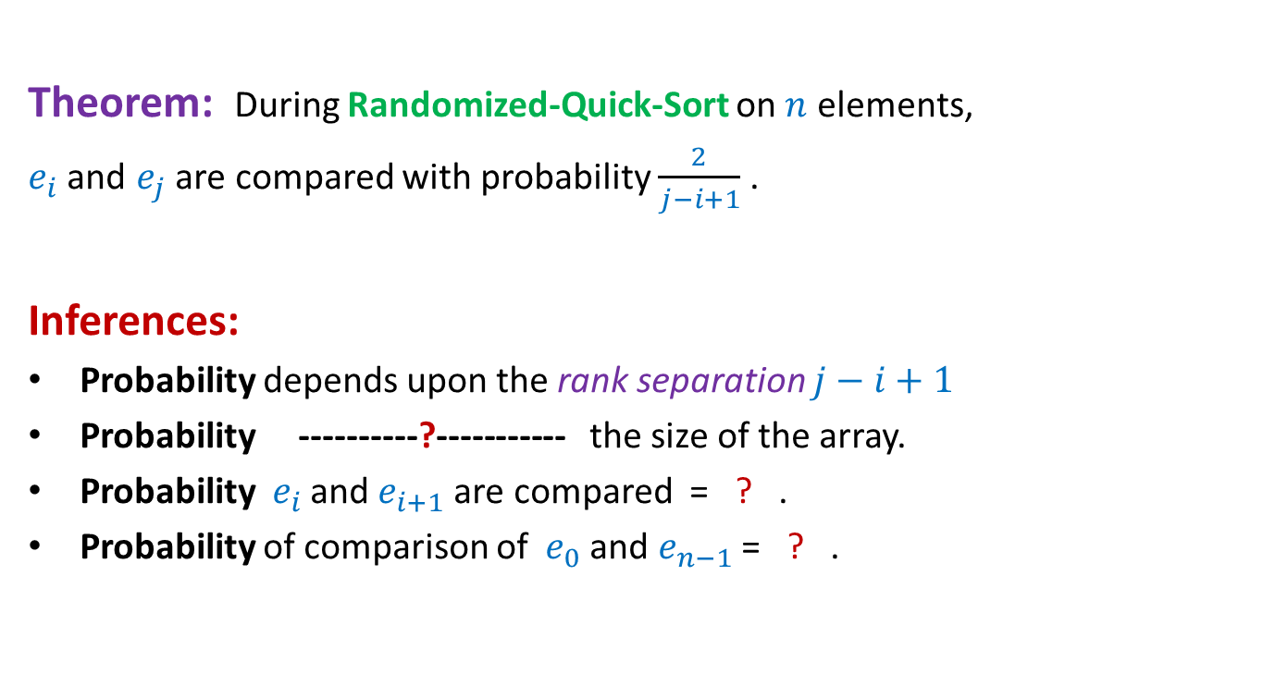


Randomized Quick Sort from perspective of $e_{i}$and $e_{j}$
Theorem: During Randomized-Quick-Sort on $n$ elements,
$e_{i}$and $e_{j}$ are compared with probability $\frac{2}{j−i+1}$ .
Inferences:
Probability depends upon the rank separation $j−i+1$
Probability ----------?----------- the size of the array.
Probability ${ e}_{i}$and $e_{i+1}$are compared = ? .
Probability of comparison of ${ e}_{0}$and $e_{n−1}$= ? .
is independent of
$$1$$
$$\frac{2}{n}$$

Slide 30
probability theory
Random variable
and
expected value

Slide 31

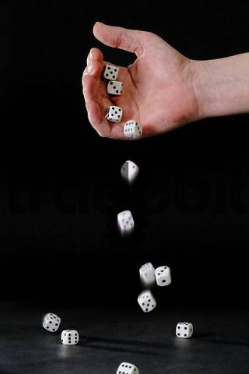
Random variable
Randomized-Quick-Sort
on array of size n
Number of HEADS in 5 tosses
Sum of numbers in 4 throws
Number of comparisons

Slide 32

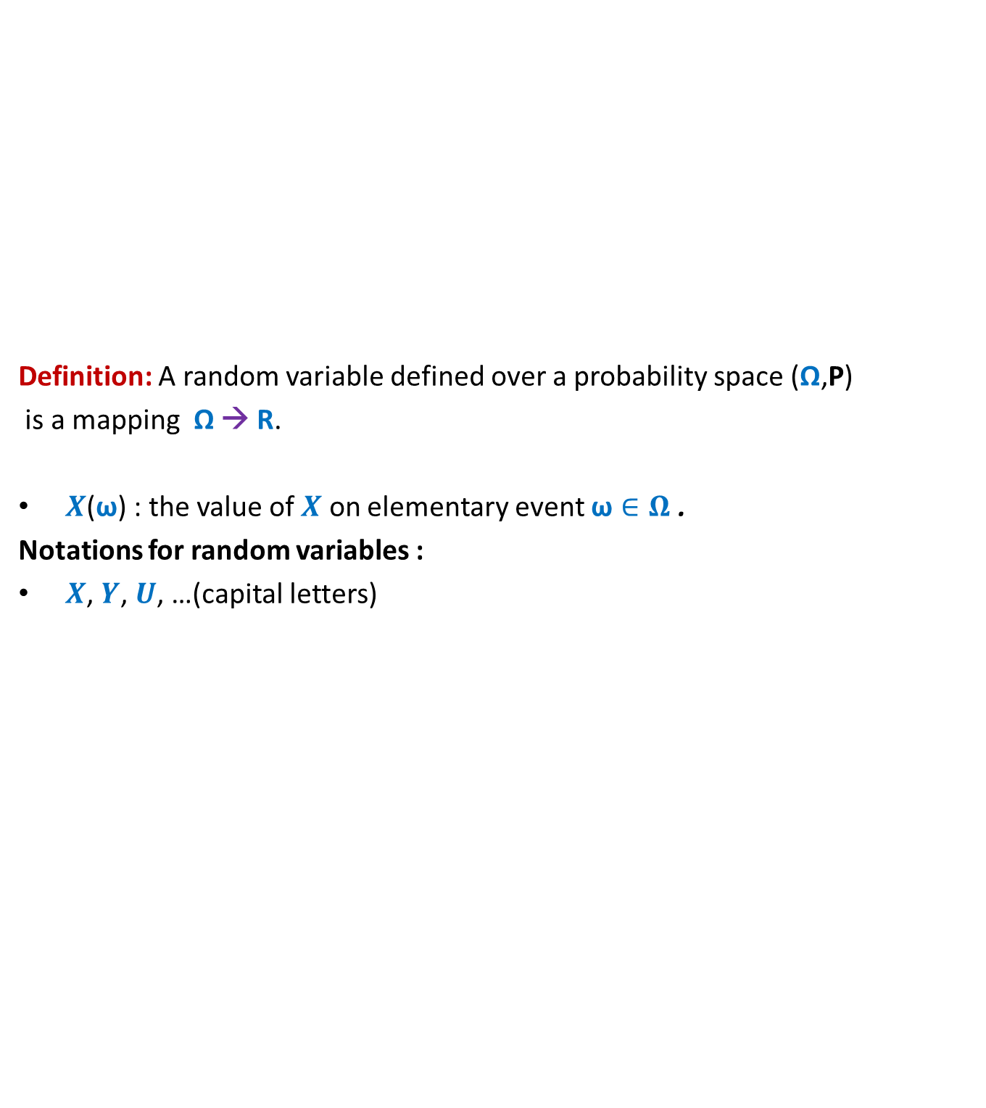
Random variable
Definition: A random variable defined over a probability space (Ω,P)
is a mapping Ω → R.
$X$($\text{ω}$) : the value of $X$ on elementary event $\text{ω}∈Ω$ .
Notations for random variables :
$X$, $Y$, $U$, …(capital letters)
$$X$$
Set of real numbers
R
Ω

Slide 33
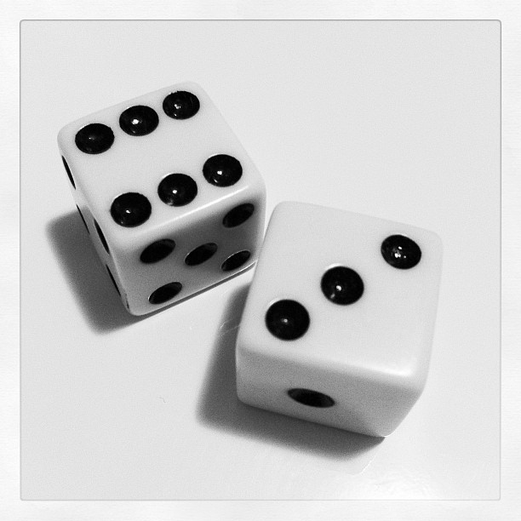
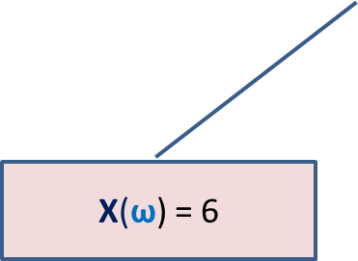
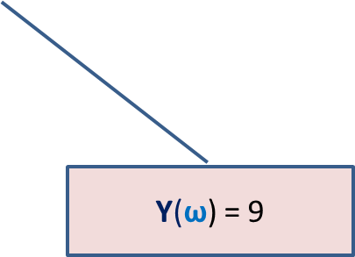

Many Random Variables for the same Probability space
Random Experiment: Throwing a dice two times
X : the largest number seen
Y : sum of the two numbers seen
X($\text{ω}$) = 6
$$\text{ω}$$
Y($\text{ω}$) = 9

Slide 34
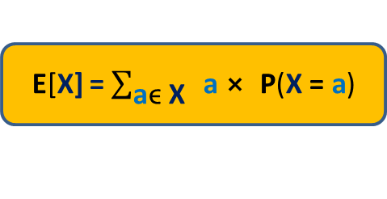

Expected Value of a random variable (average value)
Definition: Expected value of a random variable X defined over a probability space (Ω,P) is
E[X] = $\sum_{\text{ω}\text{ϵ} \text{Ω}}{\text{X}\text{(}\text{ω}\text{)}⨯ \text{P}\text{(}\text{ω}\text{)}}$
X= c
Ω
X= a
X= b
E[X] = $\sum_{\text{a}\text{ϵ} \text{X}}{ \text{a}⨯ \text{P}\text{(}\text{X}\text{ = }\text{a}\text{)}}$

Slide 35
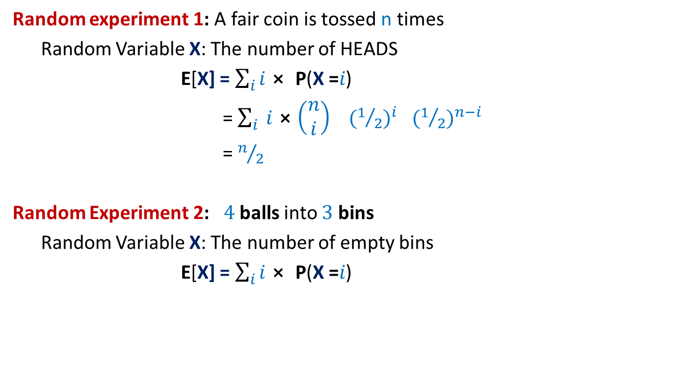
Examples
Random experiment 1: A fair coin is tossed n times
Random Variable X: The number of HEADS
E[X] = $\sum_{i}{i⨯ \text{P}\text{(}\text{X}\text{ =}i\text{)}}$
= $\sum_{i}{ i⨯\left(\begin{matrix}n \\ i\end{matrix}\right)}{ (1/2)}^{i}{ (1/2)}^{n−i}$
= $n/2$
Random Experiment 2: $4$balls into $3$ bins
Random Variable X: The number of empty bins
E[X] = $\sum_{i}{i⨯ \text{P}\text{(}\text{X}\text{ =}i\text{)}}$

Slide 36
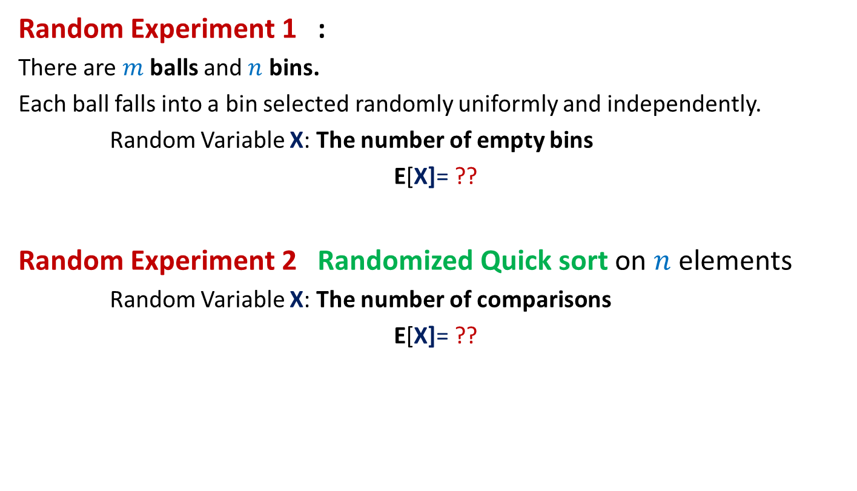
Can we solve these problems ?
Random Experiment 1 :
There are $m$balls and $n$ bins.
Each ball falls into a bin selected randomly uniformly and independently.
Random Variable X: The number of empty bins
E[X]= ??
Random Experiment 2 Randomized Quick sort on $n$ elements
Random Variable X: The number of comparisons
E[X]= ??

Slide 37
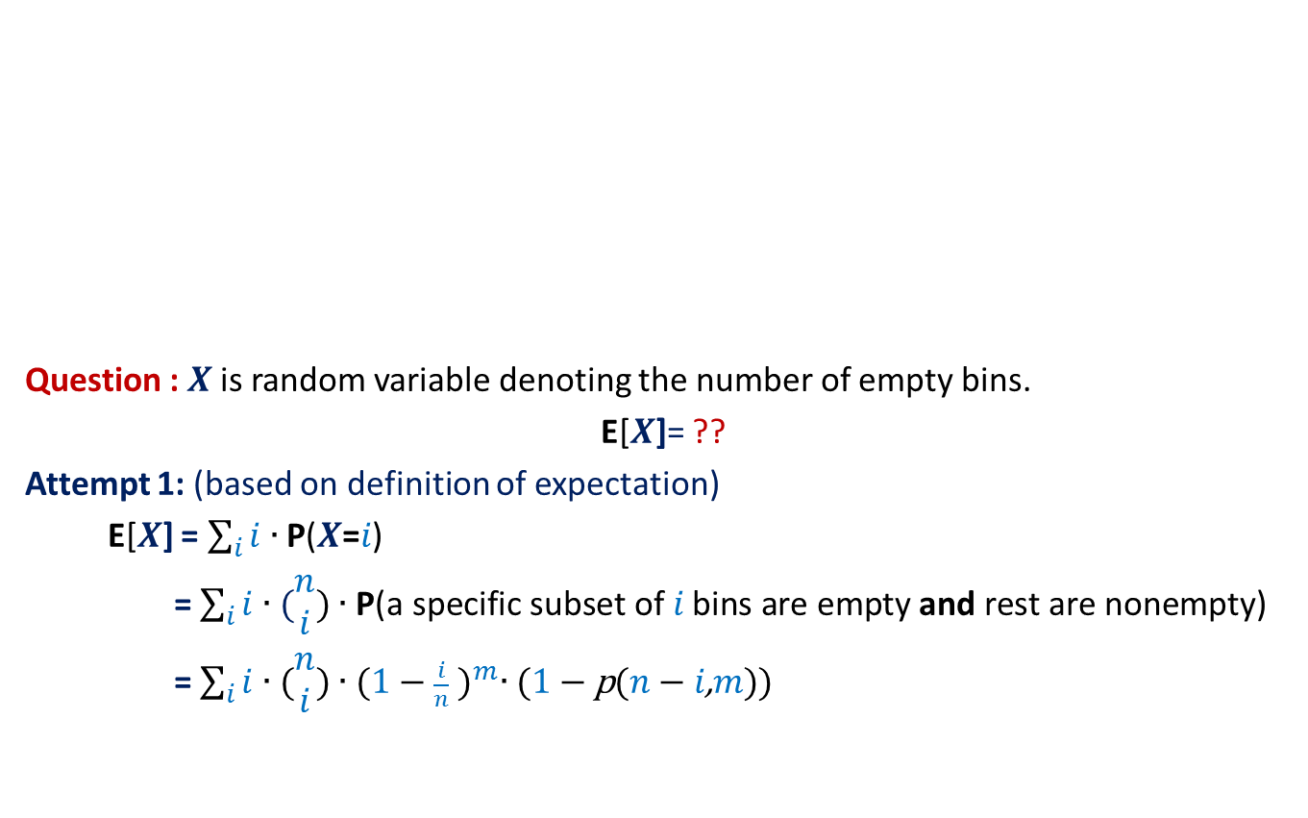


Balls into Bins (number of empty bins)
1 2 3 4 5 … $m−1$ $m$
Question : $X$ is random variable denoting the number of empty bins.
E[$X$]= ??
Attempt 1: (based on definition of expectation)
E[$X$] = $\sum_{i}{i∙\text{P}\text{(}X\text{=}i\text{)}}$
= $\sum_{i}{i∙(\begin{matrix}n \\ i\end{matrix}\text{)}∙\text{P}\text{(}\text{a} \text{specific} \text{subset} \text{of} i \text{bins} \text{are} \text{empty} \text{and} \text{rest} \text{are} \text{nonempty}\text{)}}$
= $\sum_{i}{i∙(\begin{matrix}n \\ i\end{matrix}\text{)}∙{(1−\frac{i}{n} )}^{m}∙\text{(}\text{1}−\text{p}\text{(}n−i\text{,}m\text{))}}$
A subset of $i$ bins
1 2 3 … … $n$
This is a right answer.
But it is useless !

